Slide 1
DEV 102 - Getting Started with AngularJS 2 in a SharePoint World
Ryan Schouten
SharePoint Fest Seattle 2016

Slide 2





Ryan Schouten
Worked with SharePoint for > 9 years
I have experience with SharePoint 2003 – 2016
I have worked with ASP.Net for 15 years
MCPD, MCT, MCSE: SharePoint, MCSA: Office 365
Contact Information
Ryan@sharepointknight.com
@shrpntknight
http://www.sharepointknight.com

Slide 3

Office365 Implementations
Custom SharePoint Development
Responsive Design
Intranet Design/Implementations

Slide 4
Agenda
Angular Basics
TypeScript
Differences Between Angular1 and Angular 2
Working with SharePoint

Slide 5

AngularJS
AngularJS History
Developed in 2009 to support a custom website
The site flopped and AngularJS was released as an open source library
Backed by Google
Follows MV* Pattern

Slide 6
Angular Basics
Modules
Components
DataBinding

Slide 7
Modules
These are the main grouping for components
This is usually your app.
@NgModule({
imports: [
BrowserModule, FormsModule
],
declarations: [
SharePointData
],
bootstrap: [ SharePointData ]
})
export class SharePointAppModule { }

Slide 8
Components
This is where you functionality goes.
Similar to AngularJS Directives
@Component({
selector: 'sharepointdata',
templateUrl: '/demo/spfestseattle16/sharepointdata.html',
providers: [HTTP_PROVIDERS]
})
export class SharePointData {

Slide 9
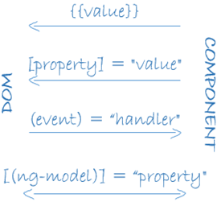
Data Flow
Interpolation
Converts value to string and outputs the value {{}}
Two Way DataBinding
[(ngModel)]
Events
Allows us to add events to our elements
(click)=“Clicked()”
Property binding
[help]

Slide 10
System Loader
Angular 2 Uses System Loader to load needed functionality
import { Component, OnInit } from '@angular/core';

Slide 11
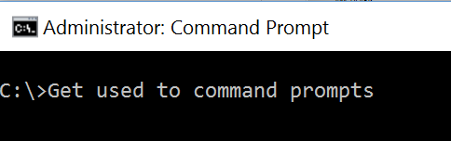

Slide 12
Angular 1 vs. 2
Two-Way databinding no longer default
Angular2 Re-written for speed and simpler implementation
No filter filter or orderBy filter
Written in TypeScript in conjunction with Microsoft
Observables instead of promises

Slide 13
TypeScript
SuperSet of JavaScript
Strongly typed
Code is Transpiled to desired version of JavaScript

Slide 14
Demo
TypeScript

Slide 15
Demo
{{DataBinding}}

Slide 16
Working with SharEPoint
Ways of Getting Data from SharePoint
REST
CSOM
Web Services
Know the limitations of each and choose what works for your needs

Slide 17
Demo

Slide 18

Questions

Slide 19
Resources
Demo Project Available on Github - https://github.com/sharepointknight
TypeScript - http://www.typescriptlang.org/
Web Essentials - http://vswebessentials.com/
AngularJS - https://www.angularjs.org/

Slide 20
Thanks
Thank your for attending SharePoint Fest
Contact Information
Ryan@sharepointknight.com
@shrpntknight
http://www.sharepointknight.com

